Slide 1
Automatic Fish Feeder

Slide 2
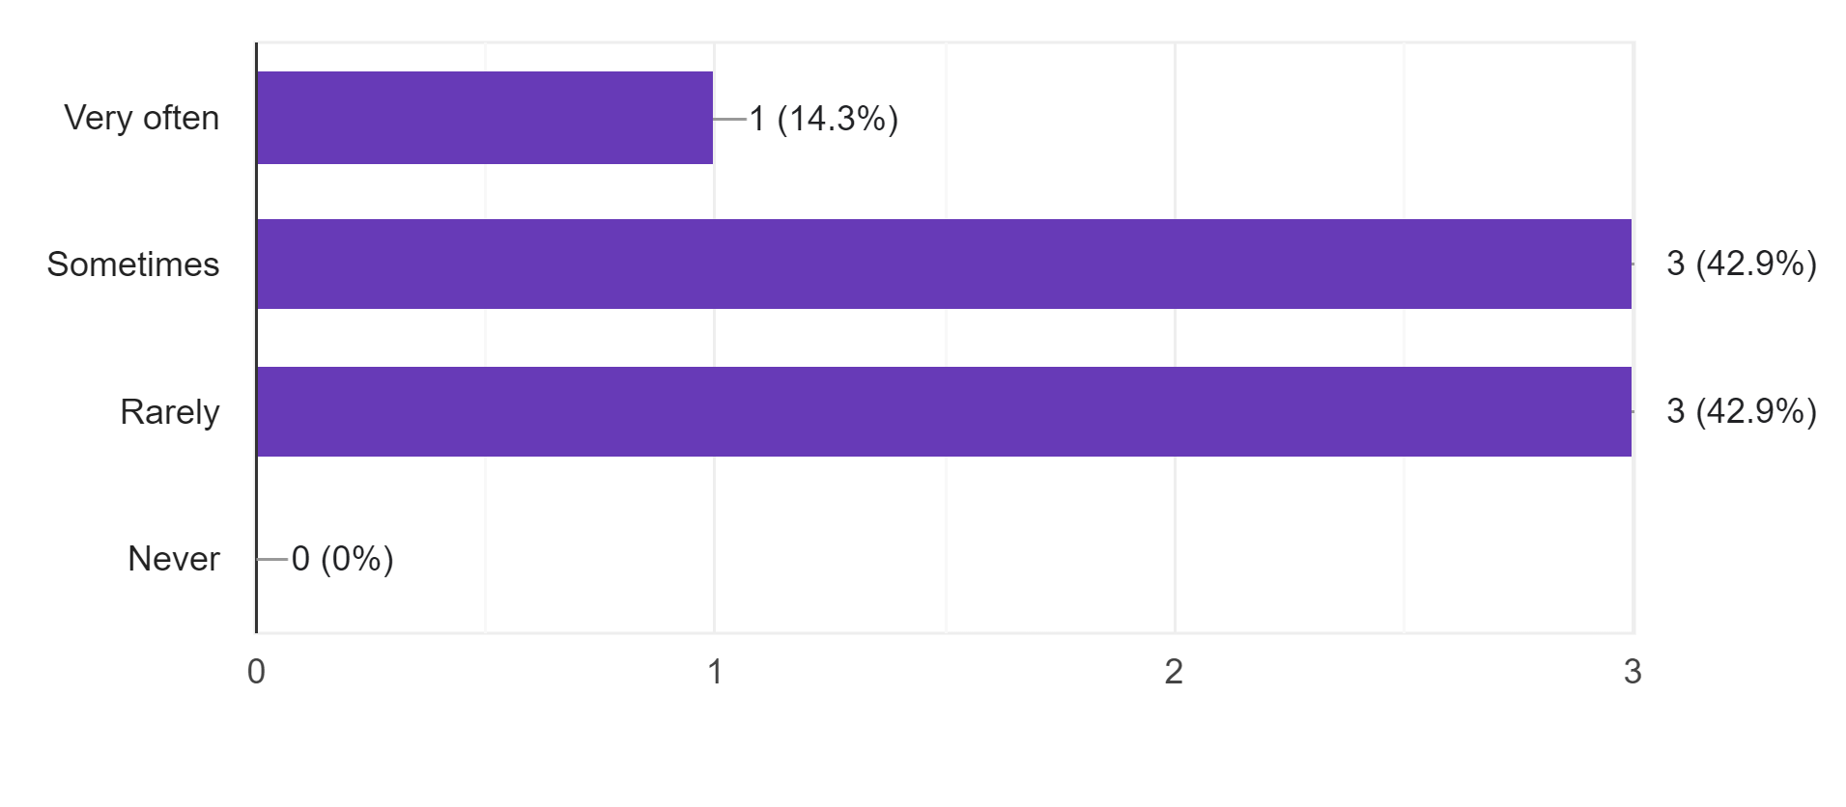
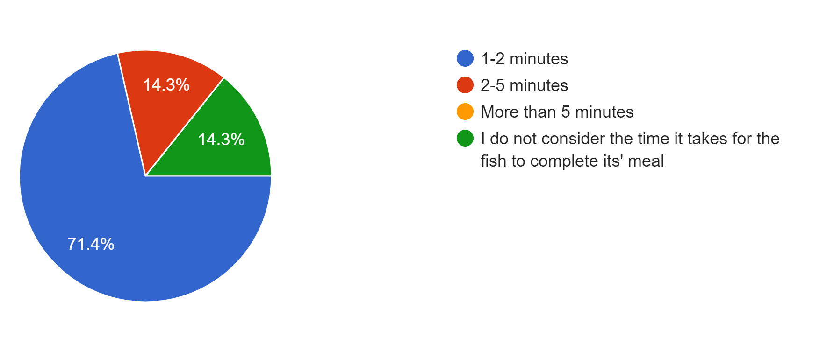
Fish Feeding
Fish tank maintenance is important
Improper maintenance degrades the appearance and is fatal to fish
Time consuming, requires commitment and constant attention
Underfeeding and overfeeding are both problematic

Slide 3
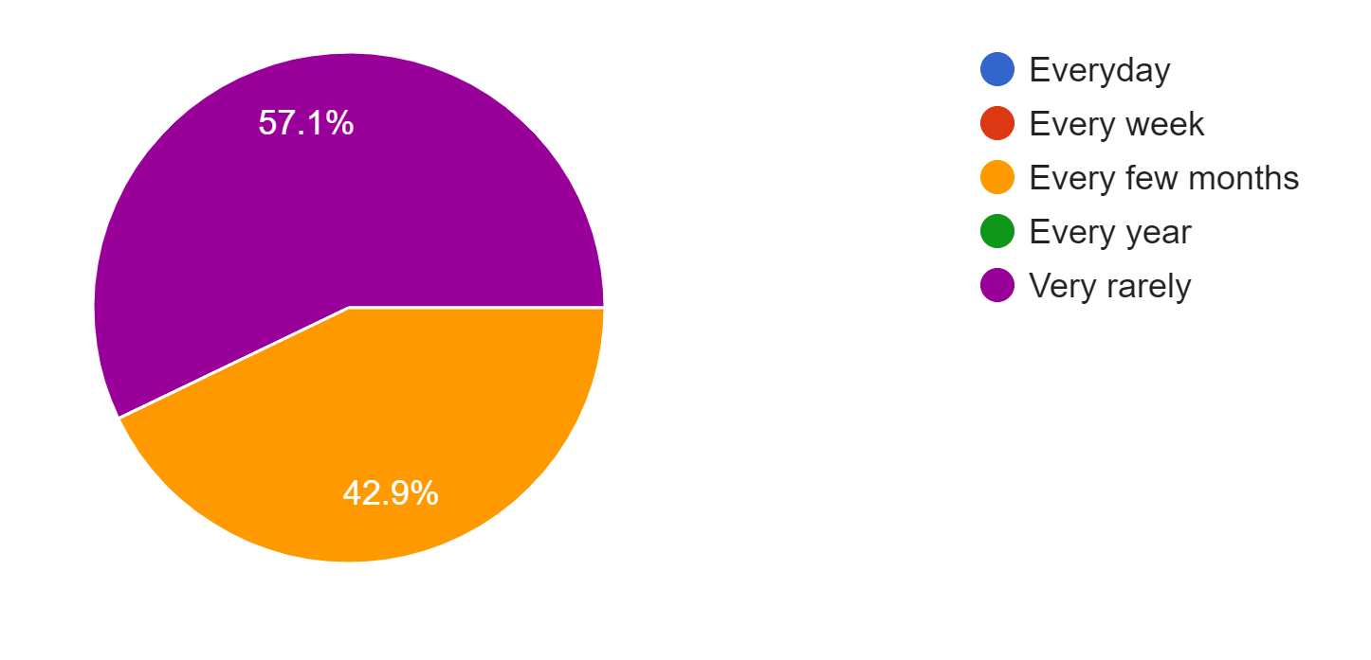
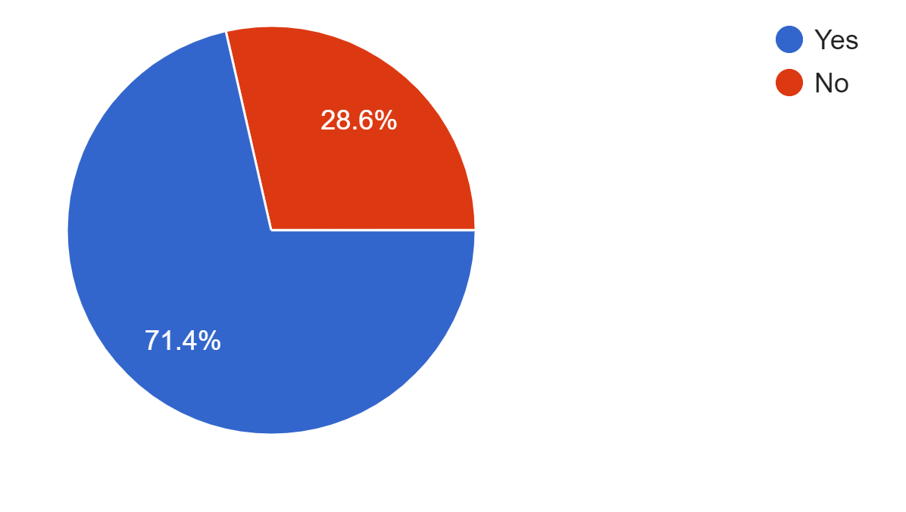
Why an automatic fish feeder?
Fish feeding is repetitive and requires precision
Most do it erroneously
They leave home sometimes or very often
Most add or remove fish and change diet every few months
Feeding should be automated with an adjustable timer

Slide 4
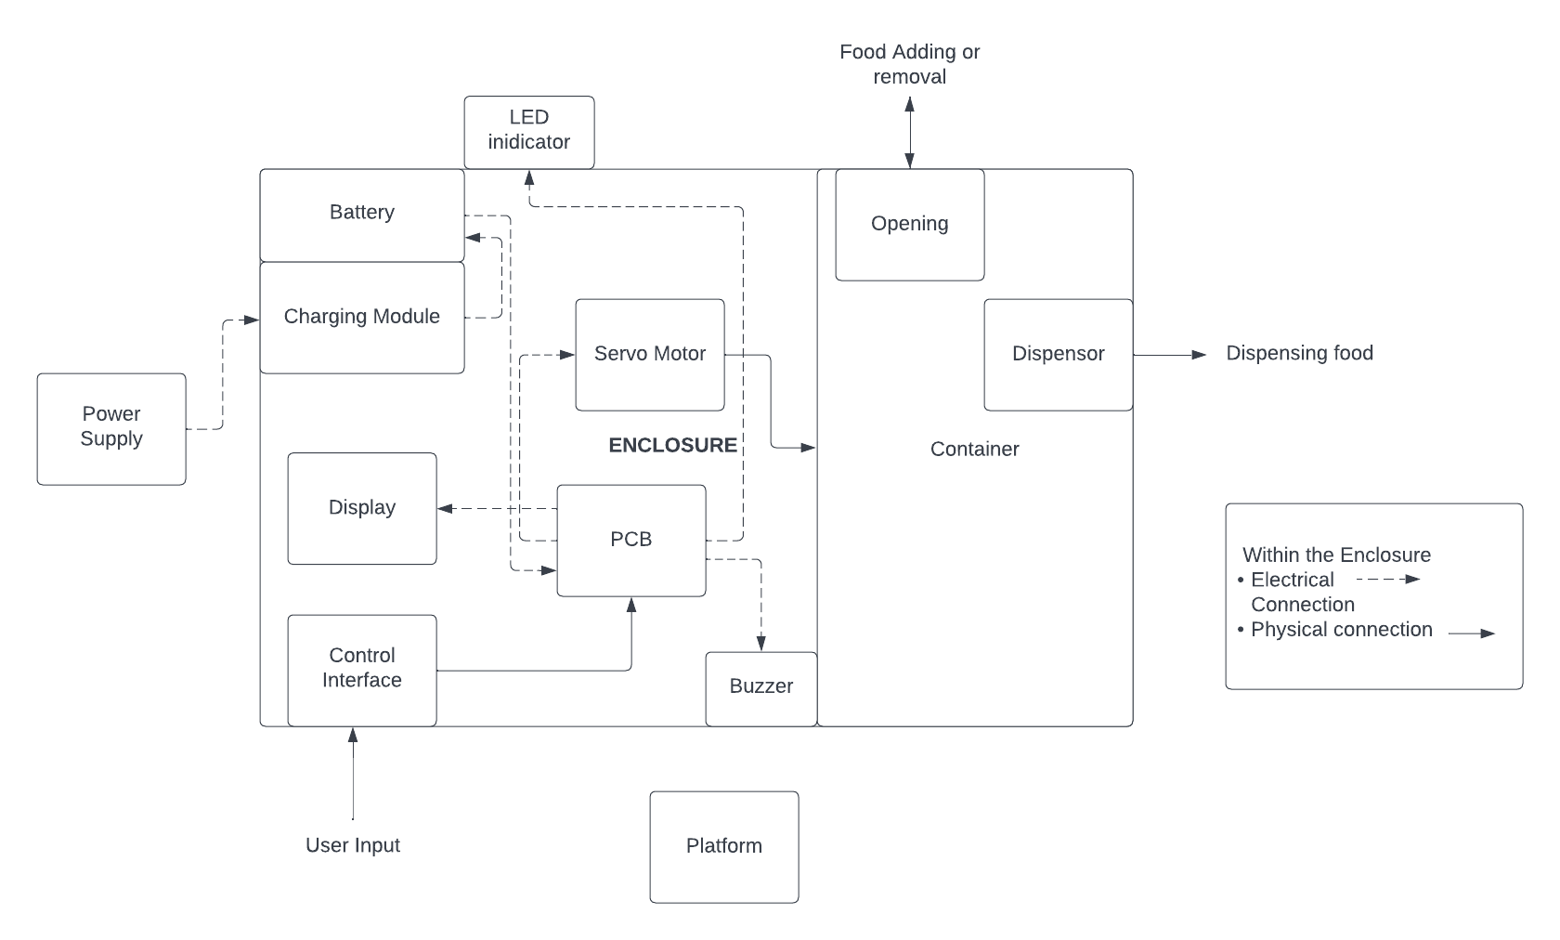
Block diagram

Slide 5
Marketing
Enclosure- PLA material
Material is recyclable and compostable
Damaged enclosures can be returned for a price
Material is recycled
Schematics and replaceable parts will be made available

